Slide 1
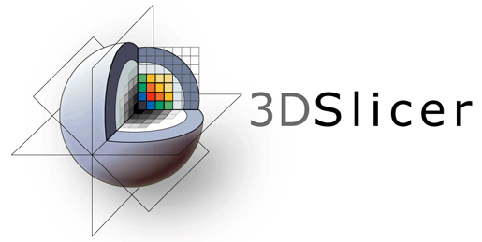
3D Slicer Data Loading and Visualization Tutorial
Csaba Pinter

Slide 2
Tutorial dataset
Please download the following dataset:
http://slicer.kitware.com/midas3/download/?items=330421,1
Unzip it to a local folder (this step is different for each operating system)

Slide 3
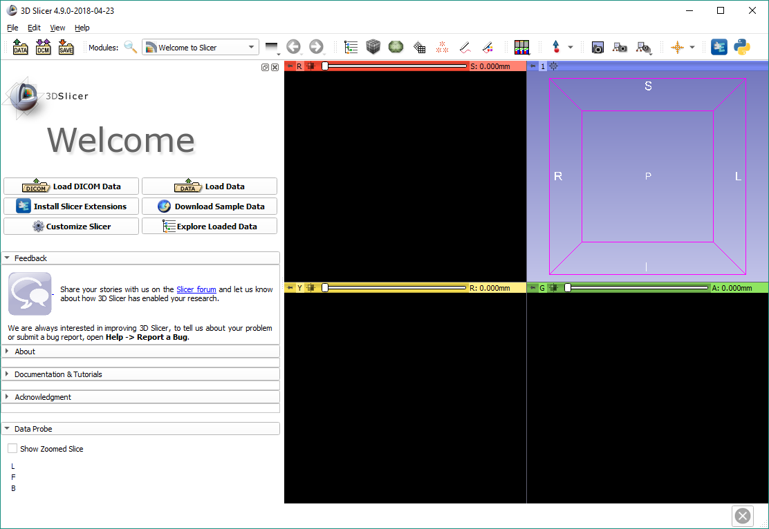
3D Slicer version 4.10
The default start-up module is the Welcome module

Slide 4
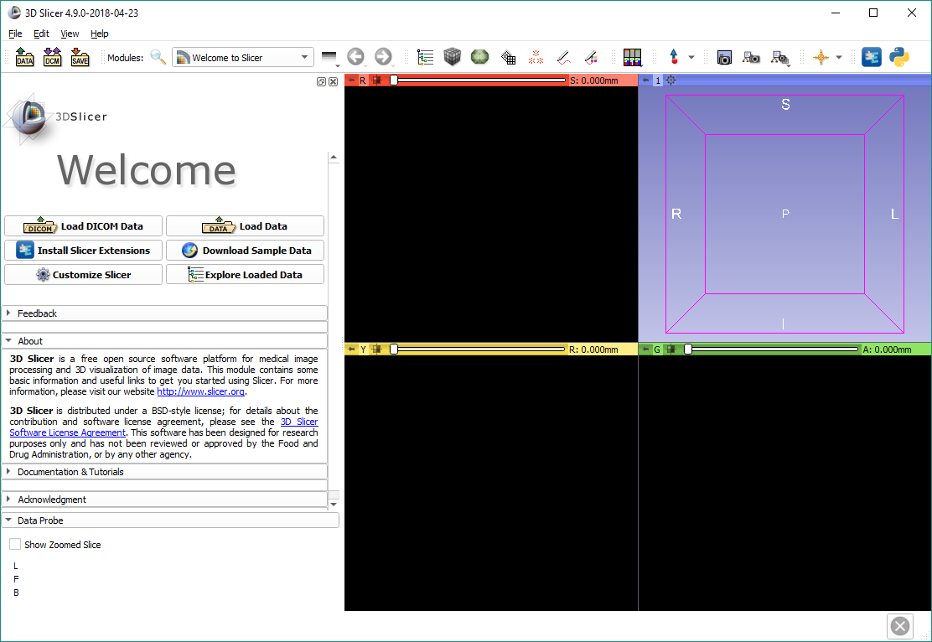

Welcome module
Each module of Slicer includes a series of tabs, which gives access to different functionalities.
Click on the arrow symbol to display the content of each tab

Slide 5
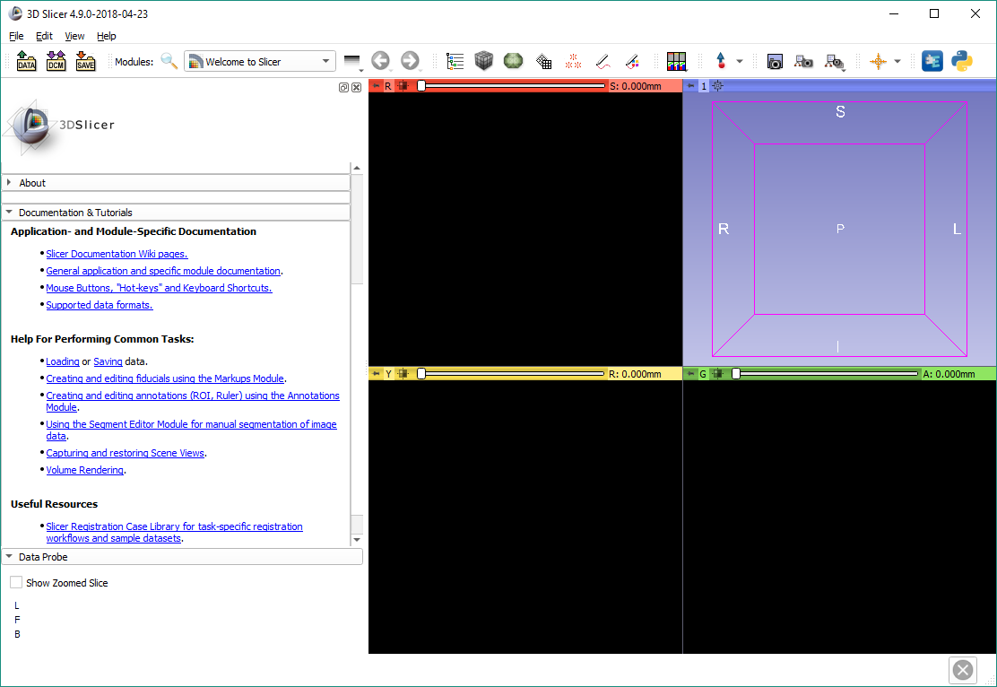
Welcome module
The Documentation & Tutorials section contains useful links to different parts of the Slicer training content.

Slide 6
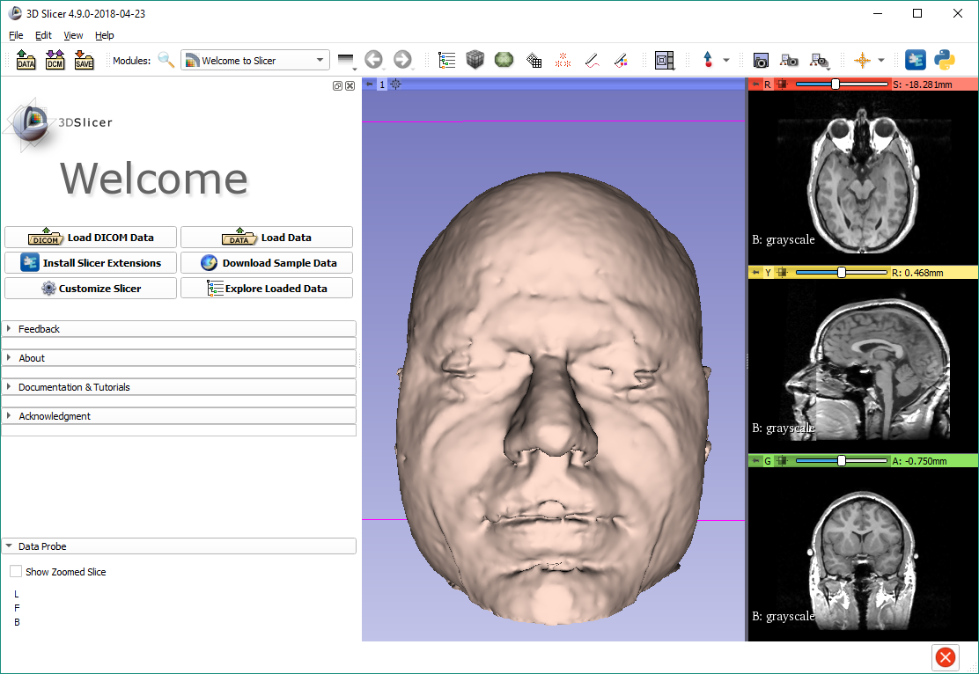
Main user interface
Toolbar
3D view
Slice views
Module panel
Data probe

Slide 7
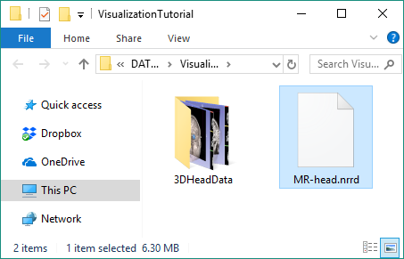
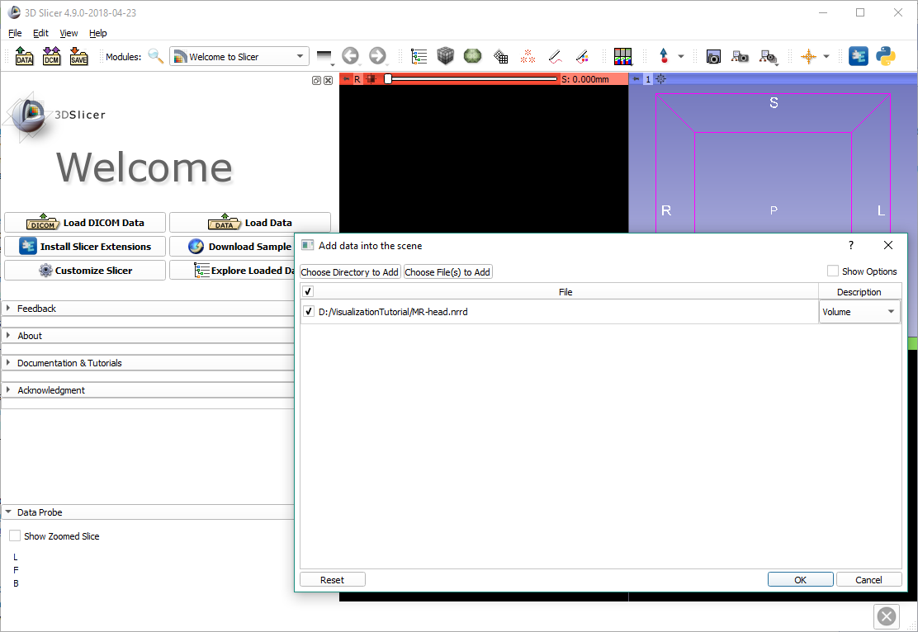
Load data from computer
Browse to the location of the MR dataset MR-Head.nrrd Drag & drop it into Slicer
Slicer automatically opens the ‘Add data into the scene’ window.
Click OK to load the volume.

Slide 8
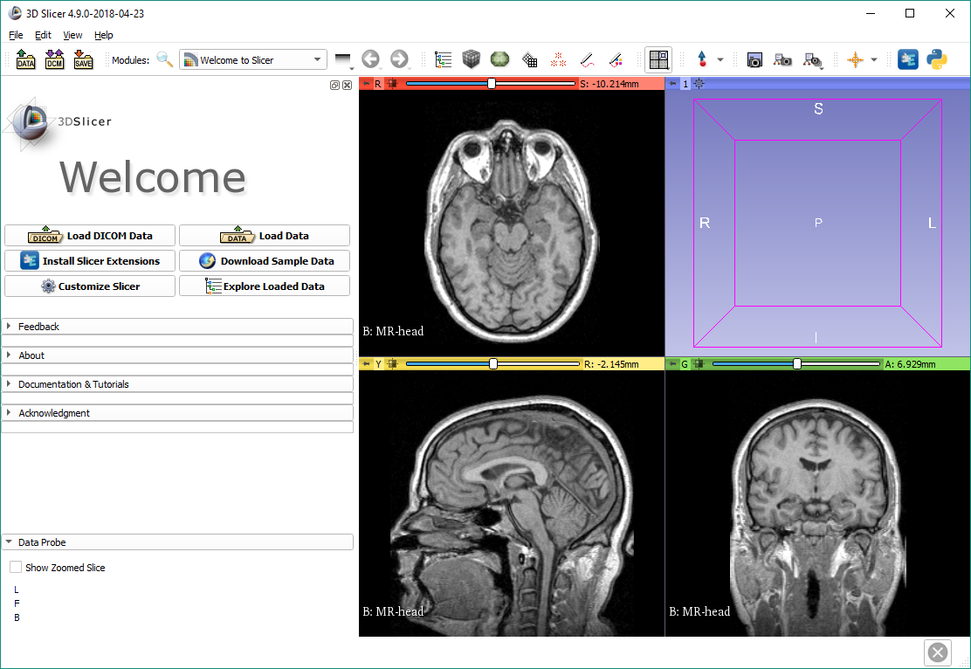
Load data from computer
The axial, sagittal, and coronal views automatically show the loaded volume

Slide 9
Switch layout
Click on the Slicer layout button

Slide 10
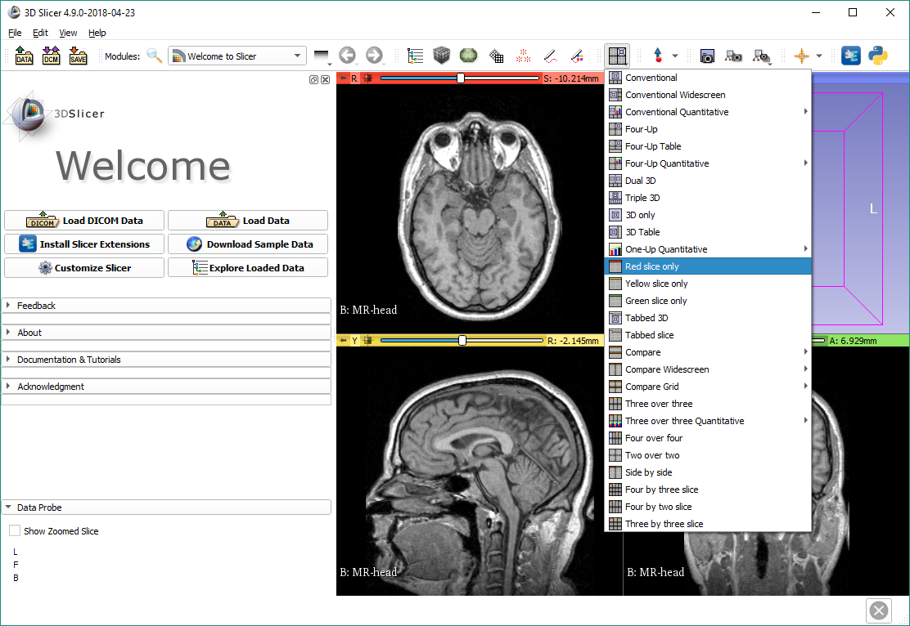
Switch layout

Slide 11
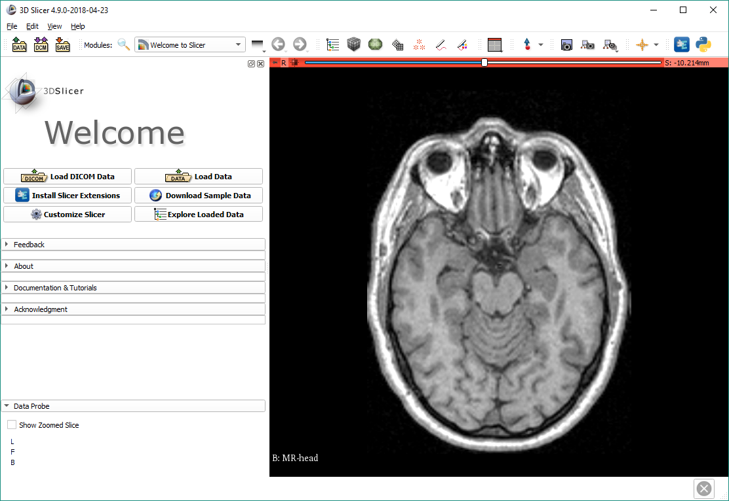
Slice view options
Position your mouse cursor over the pin icon to display the slice view toolbar

Slide 12
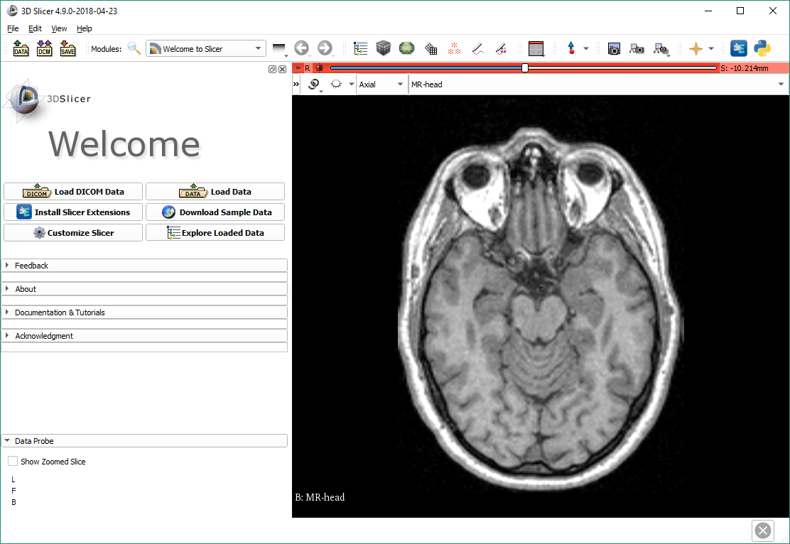
Slice view options
Once the slice viewer toolbar is shown, click on the “>>”

Slide 13
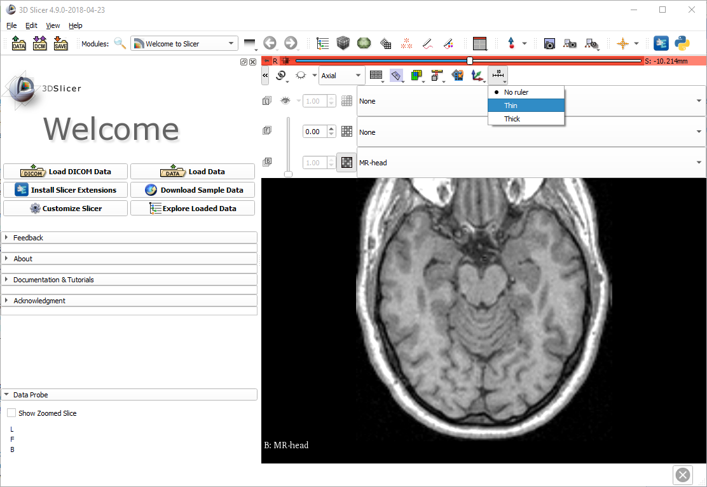
Show ruler

Slide 14
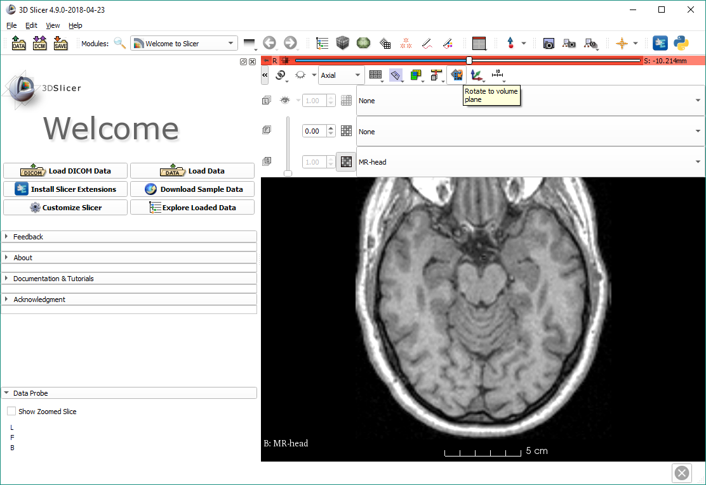
Rotate to volume plane
Often, MRI volumes are not axis-aligned. To show the true axial view, click the ‘Rotate to volume plane’ button.
Note: This image will not be affected, but many DICOM MR images need to be aligned.

Slide 15
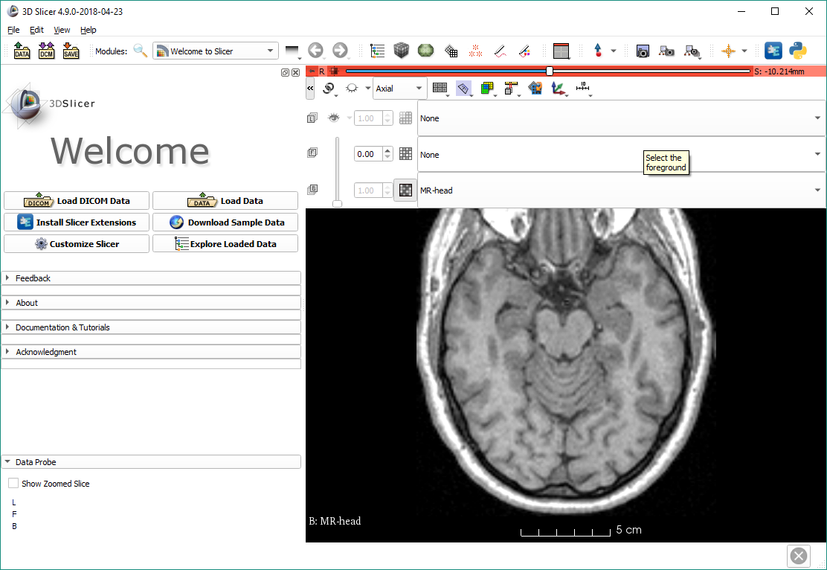
Foreground image
Images can be overlaid (“fused”) by setting the foreground image.
Note: There is no other image in the scene at this point.

Slide 16
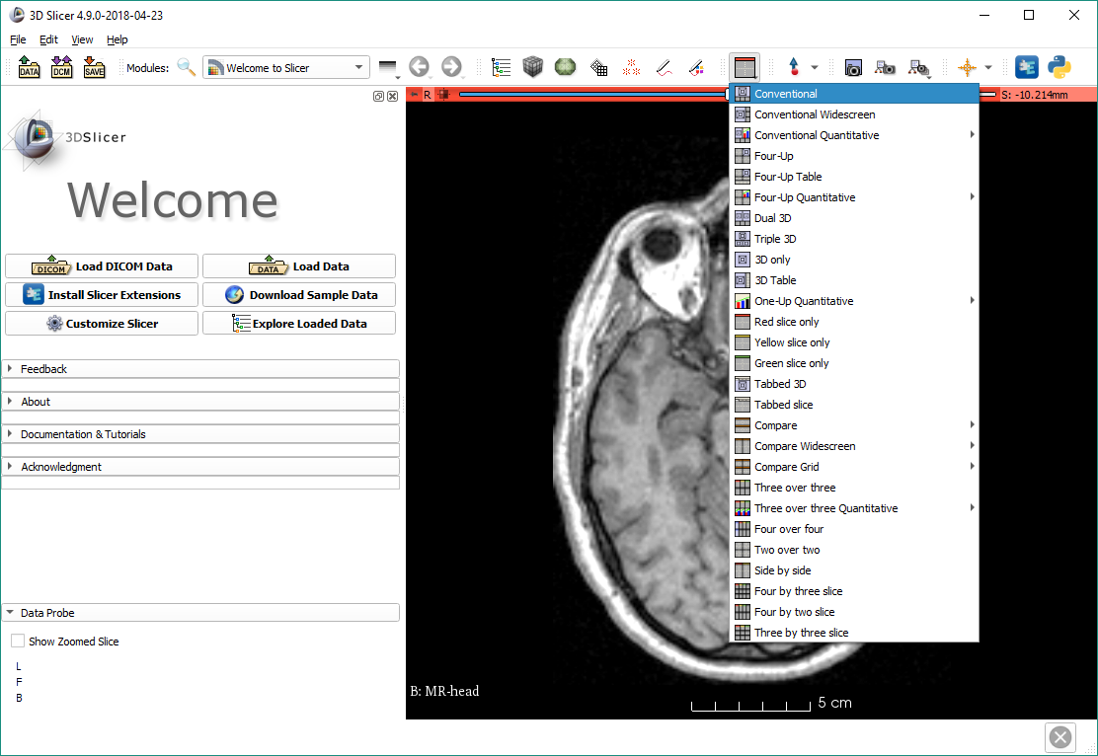
Switch to conventional layout

Slide 17
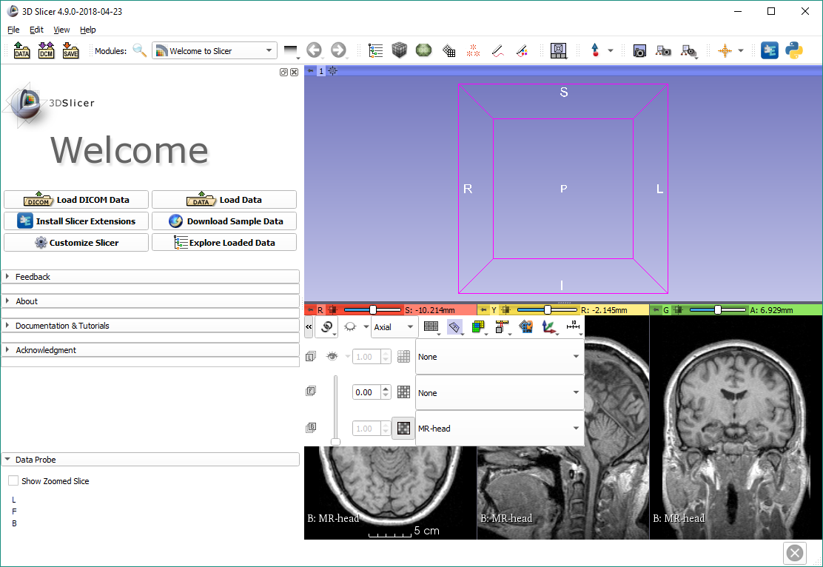
Link views
After linking views, if any setting is changed in a 2D view, all others follow.

Slide 18
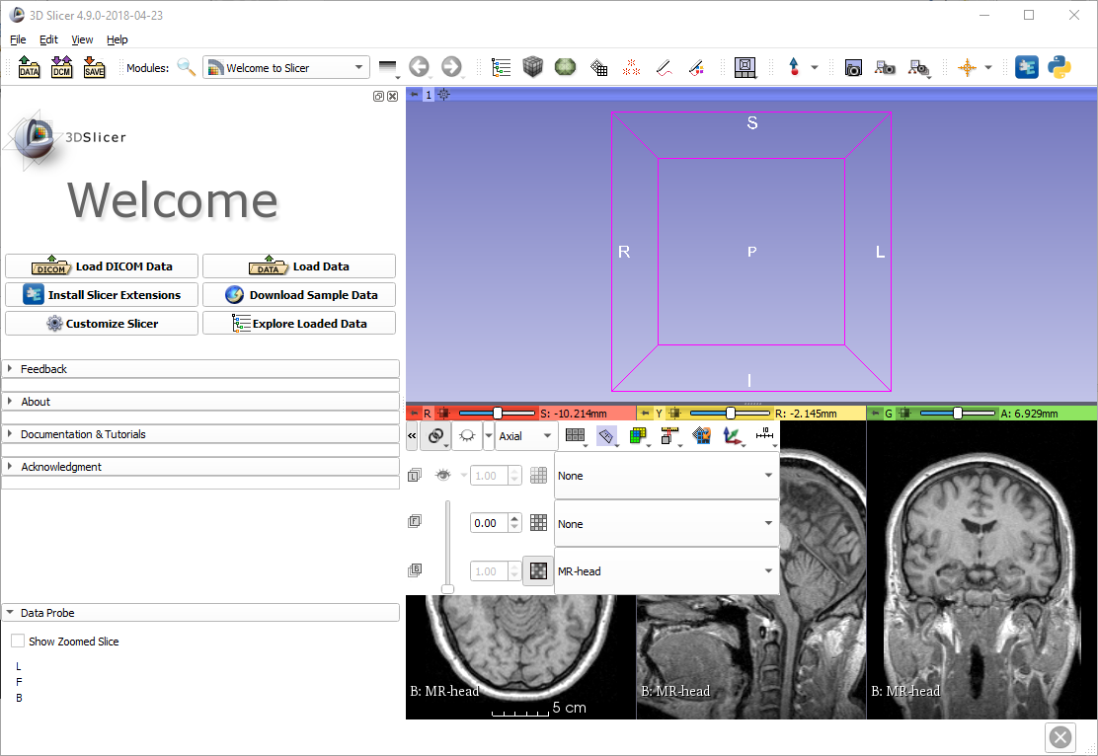
Show slices in 3D
Now the slice views are linked. If you click the ‘Toggle slice visibility in 3D view’ button, then all slices will show up.

Slide 19
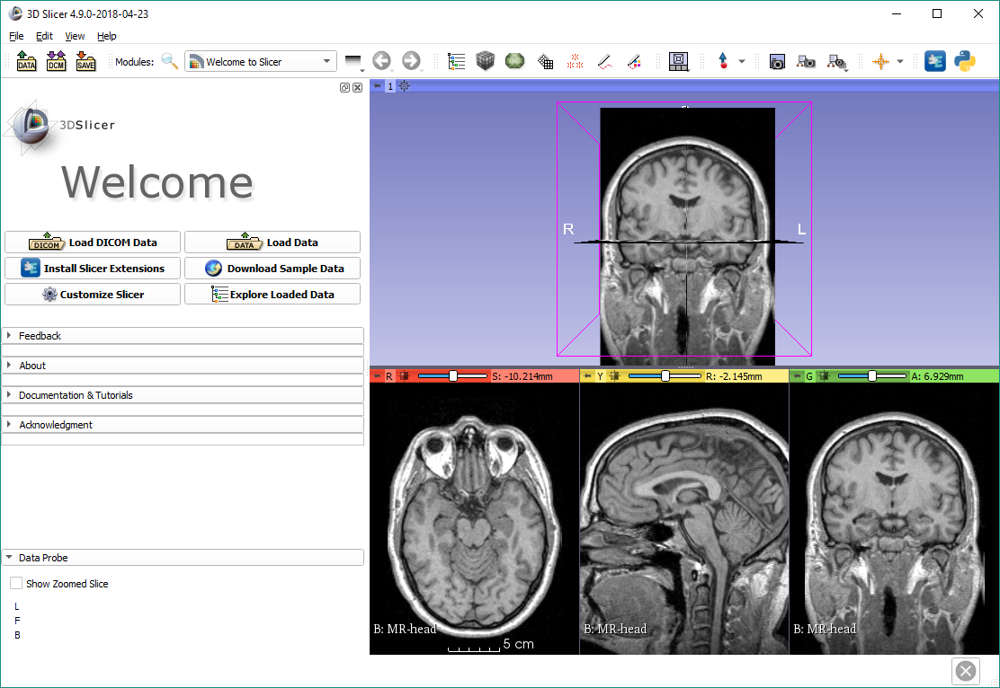
Show slices in 3D
All three anatomical slices are shown in the 3D view

Slide 20
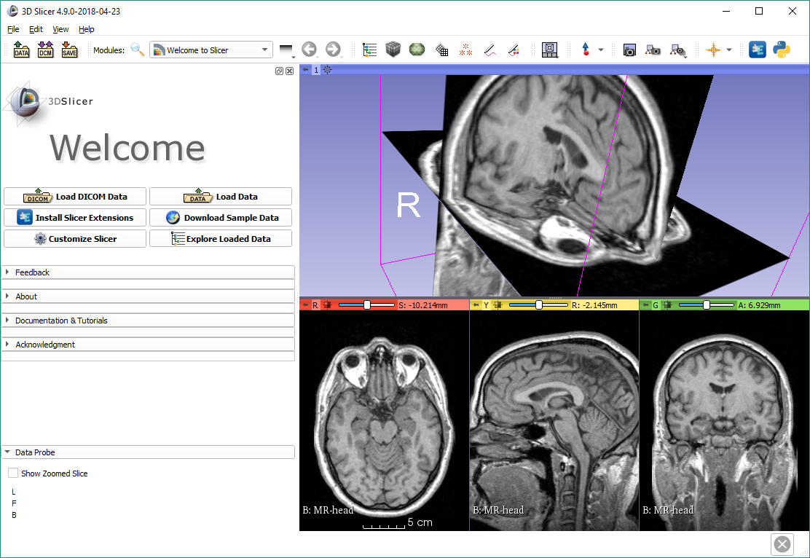
Navigating the 3D view
Use the left mouse button to rotate, and the right mouse button to zoom in and out

Slide 21
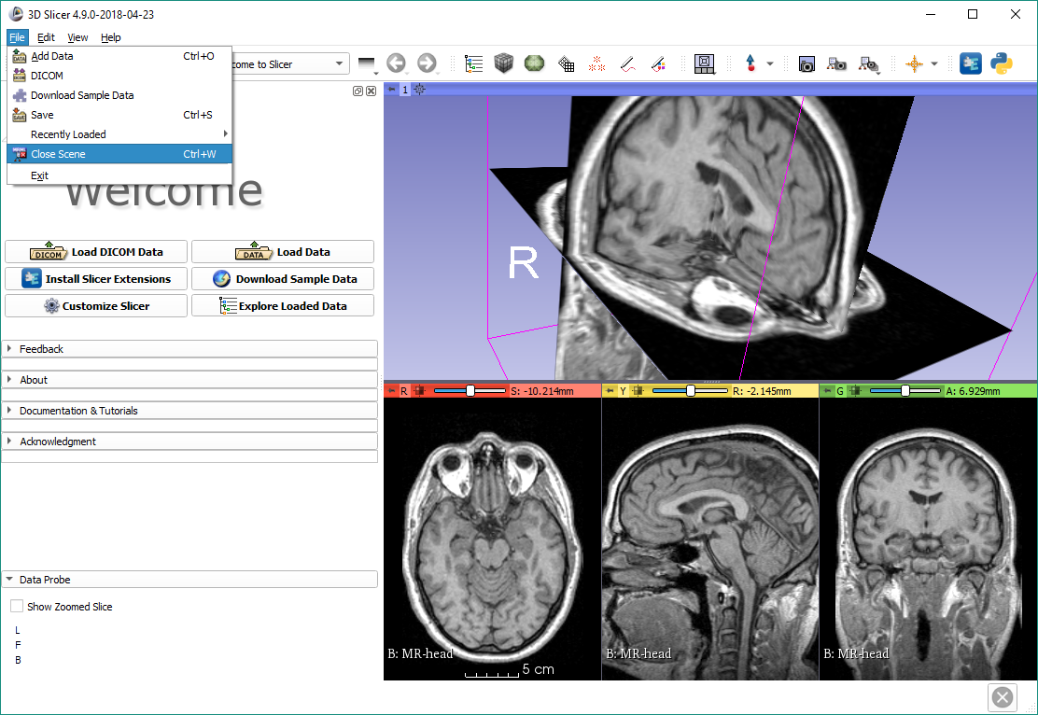
Close the scene

Slide 22
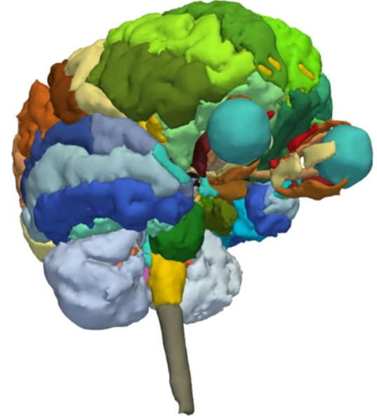
Part 2: 3D visualization of surface models of the brain

Slide 23
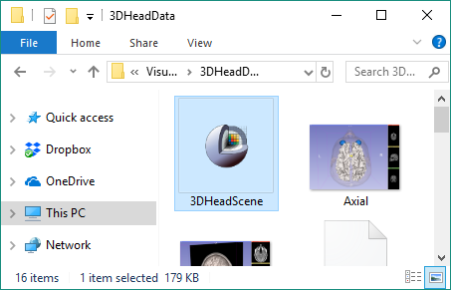
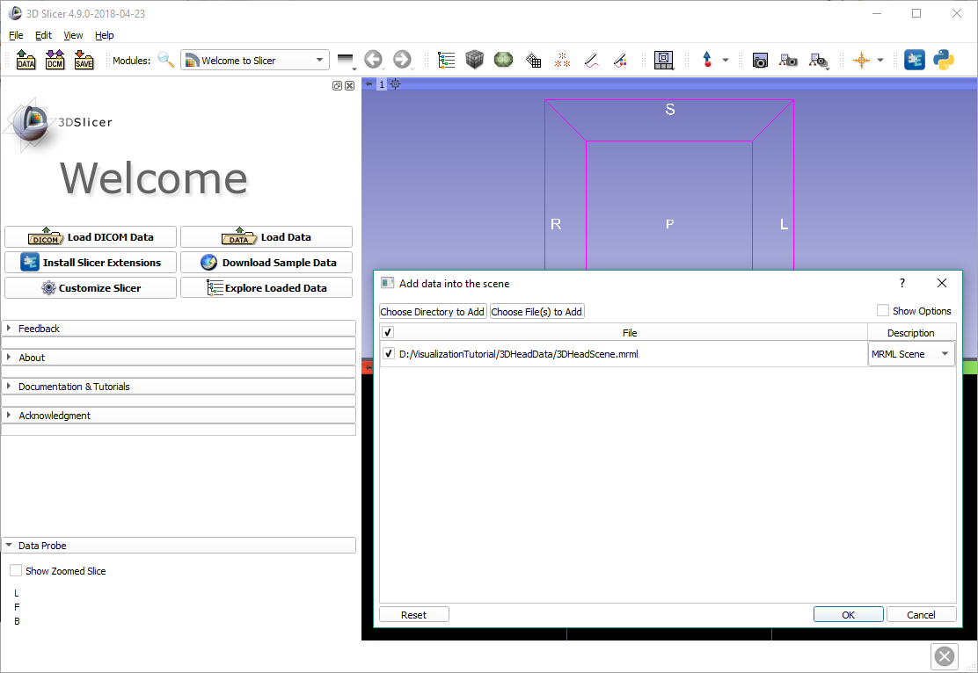
Load tutorial scene
Drag and drop the file 3DHeadScene.mrml into Slicer, then click OK

Slide 24
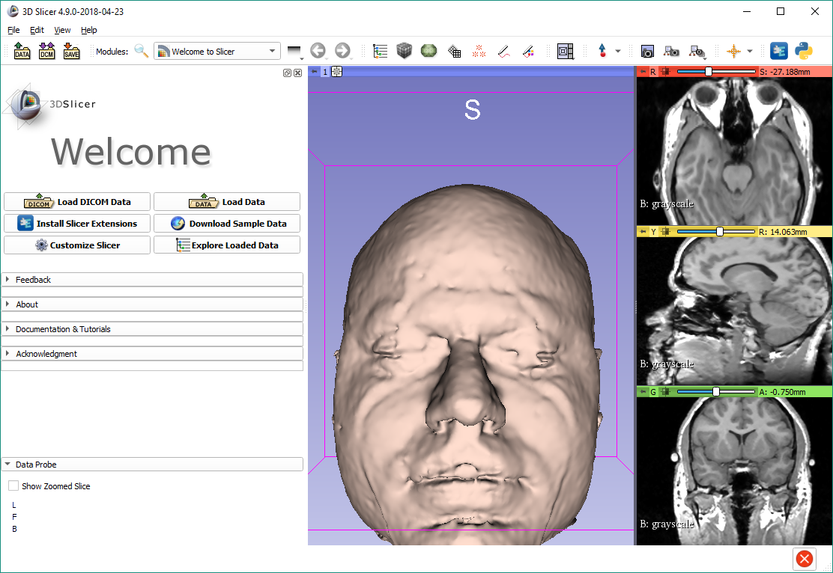
Center view
Click on the small box icon to center the view, in 3D or in 2D

Slide 25
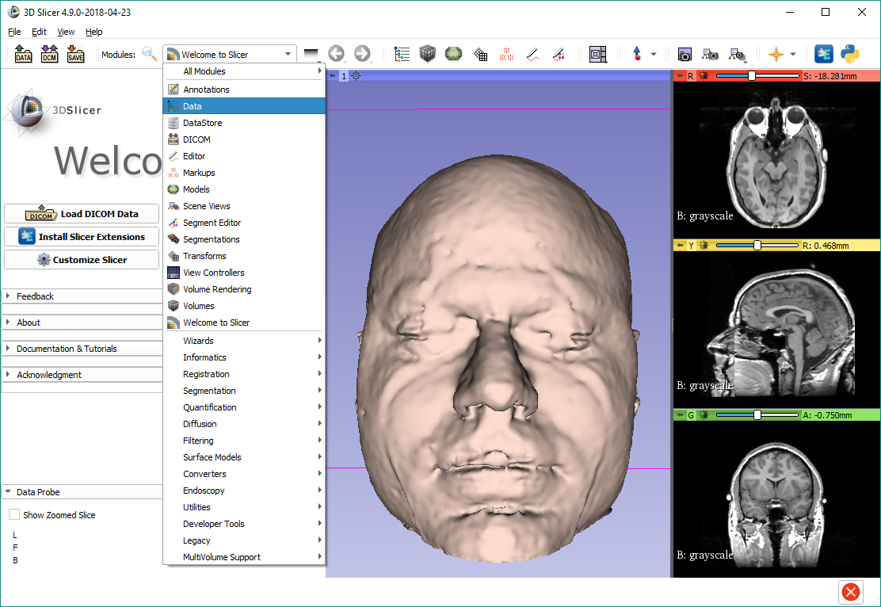
Explore loaded data
You can use the module list, or the favorite module toolbar to switch to the Data module

Slide 26
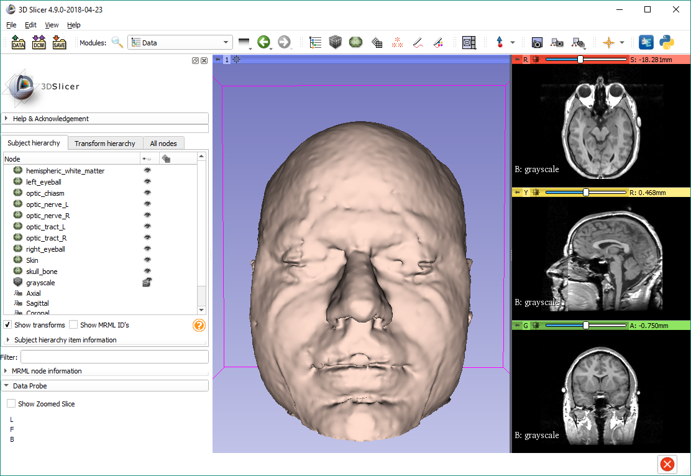
Explore loaded data
The Data module shows all the data in the scene.
The data items (“nodes”) can be shown/hidden, renamed, deleted, cloned, etc.
Hide the ‘Skin’ model by clicking the eye icon.

Slide 27
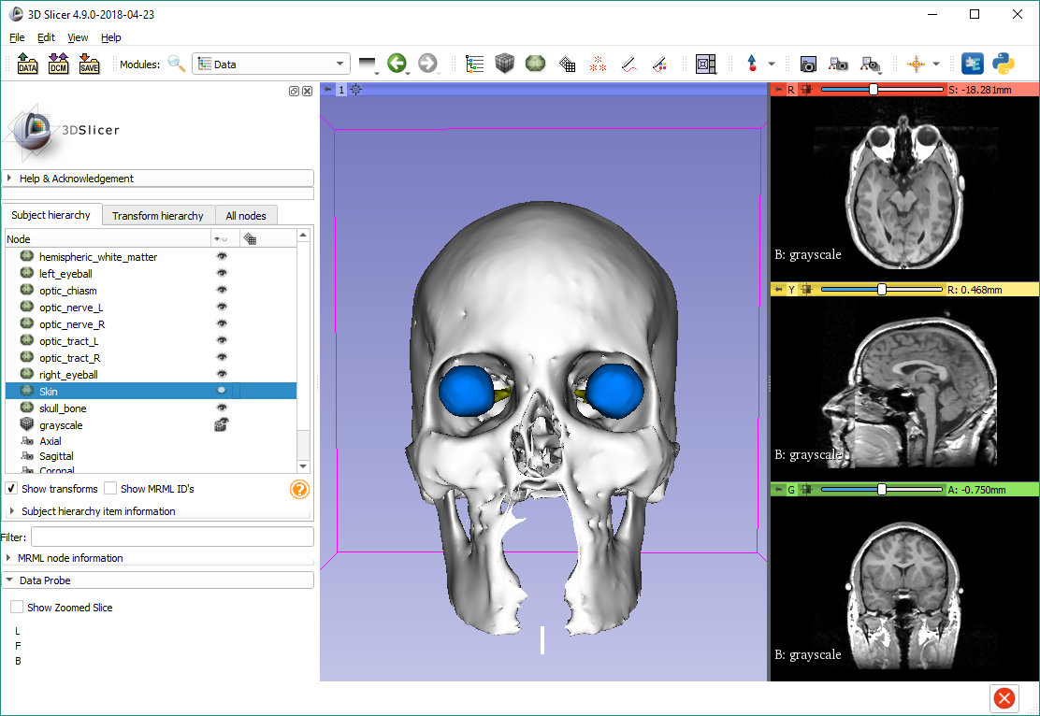
Subject hierarchy
For list of “subject hierarchy” options for a certain node, right-click it in the list. Note that the options are different for each node type.
Right-click the volume called ‘grayscale’.

Slide 28
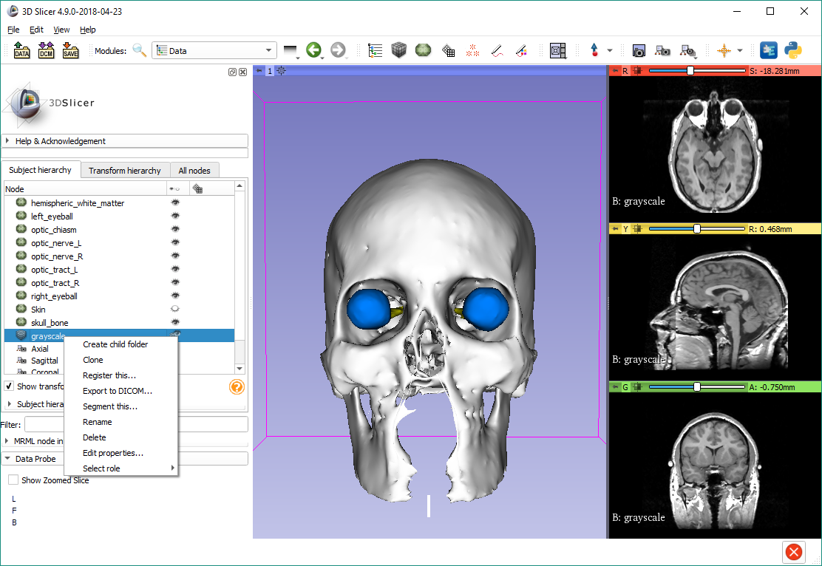
Node actions
Choose the Rename option and rename the volume to ‘MR brain’

Slide 29
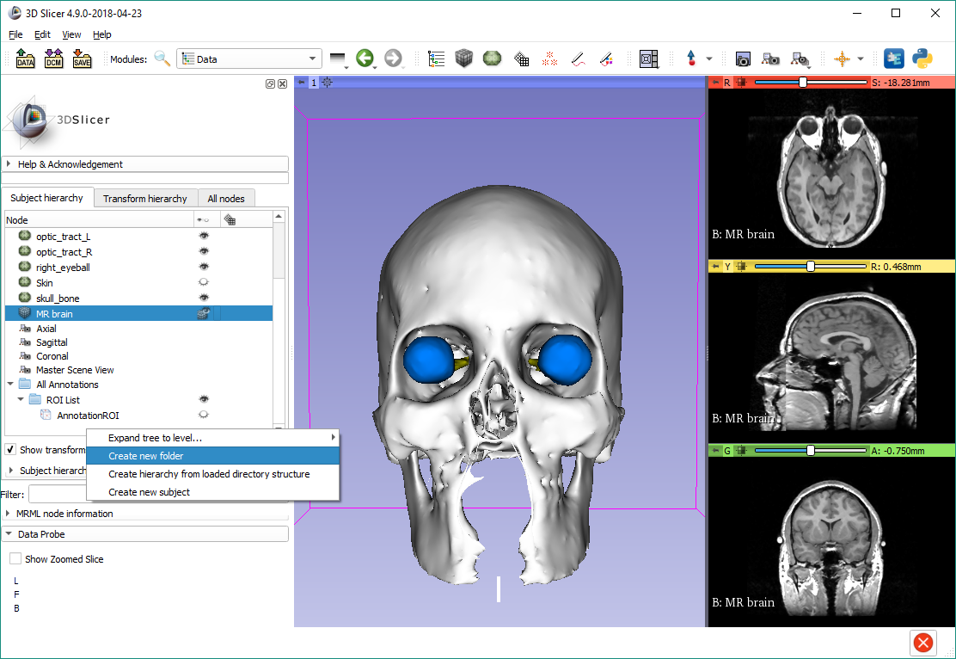
Create folder
Scroll down to the bottom, right-click the empty area, then choose ‘Create new folder’.

Slide 30
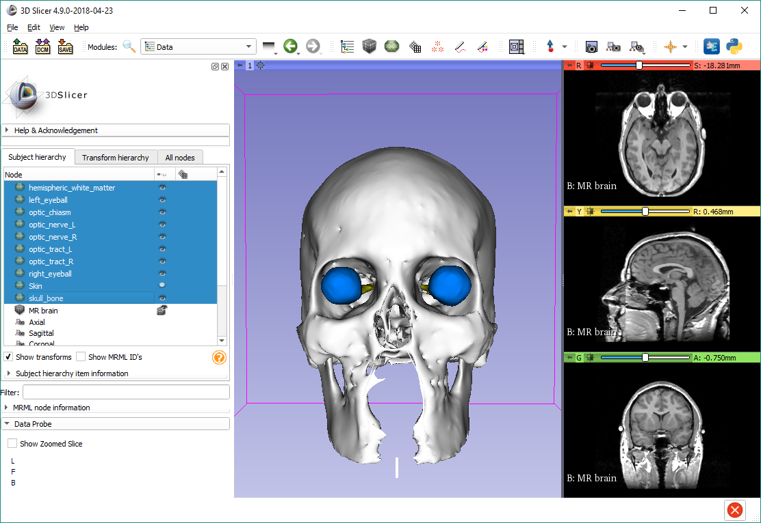
Select multiple nodes
Scroll back up, click the topmost model, hold down Shift, and click the last model.
Note: You can use Control/Cmd button to select individually.

Slide 31
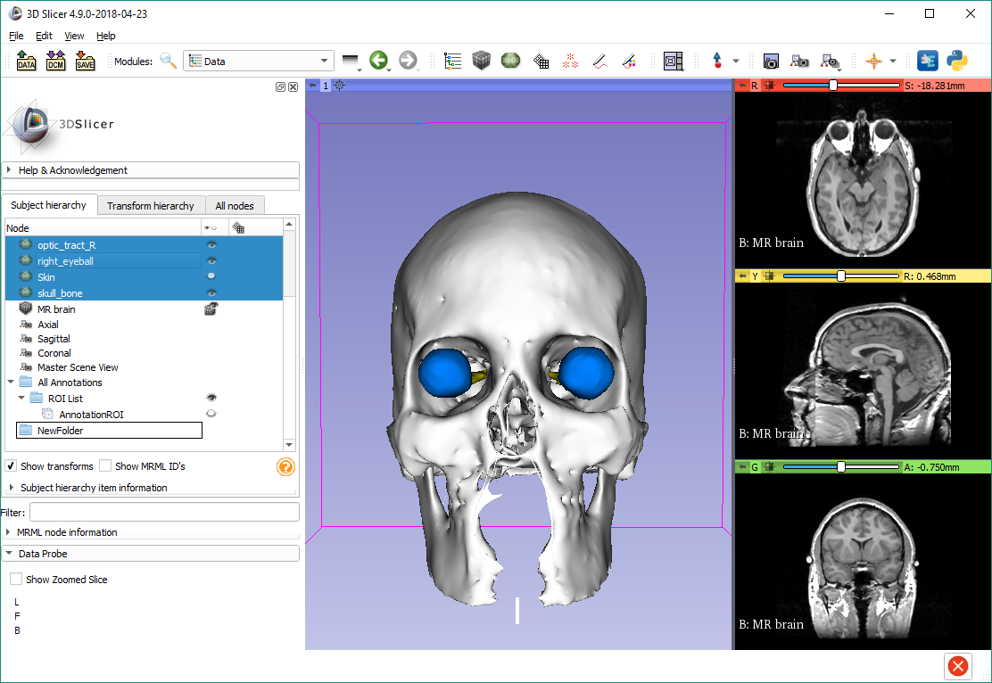
Move nodes to folder
Drag&drop models into the folder

Slide 32
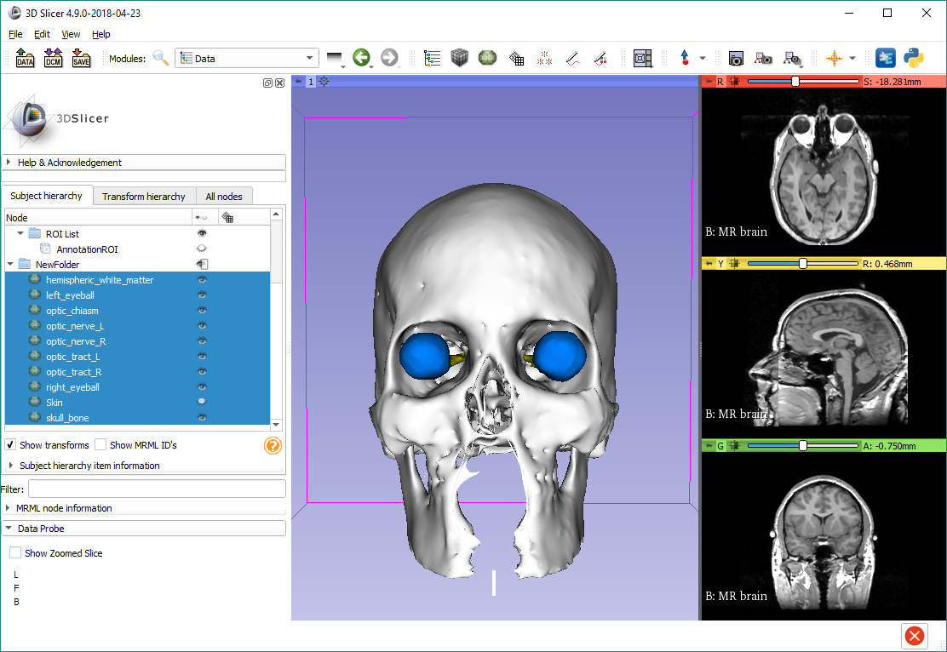
Hide all nodes in folder
The visibility icon of the folder shows partial visibility because the skin is hidden.
Click that button to hide all nodes in the folder.

Slide 33
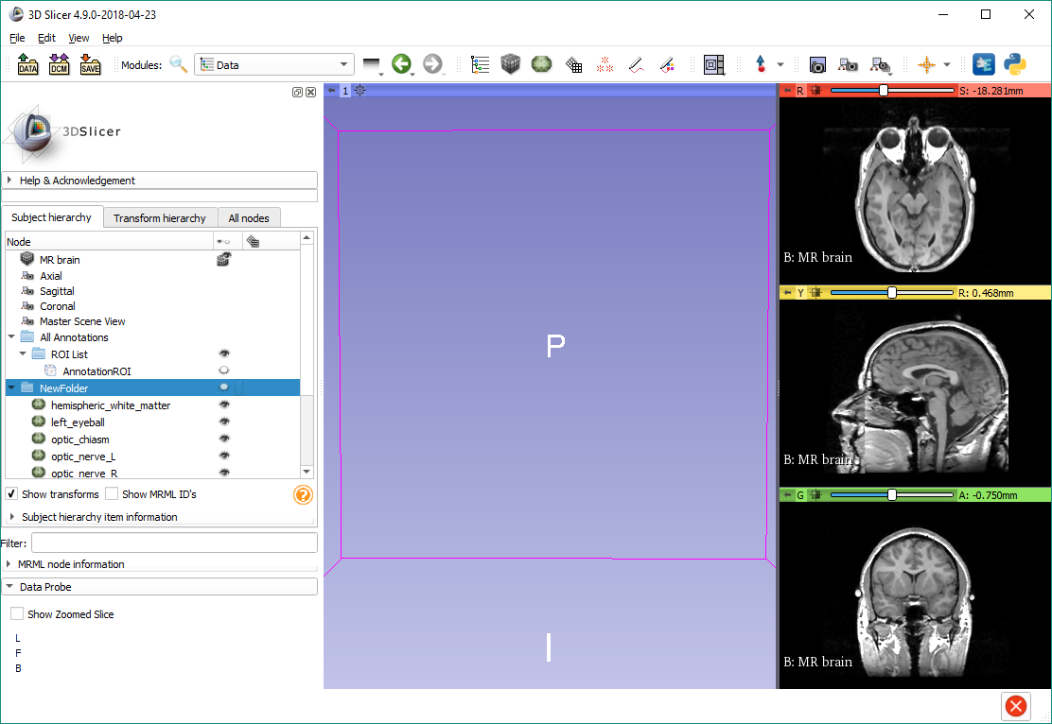
Display options
Right-click the eye icon to see display options

Slide 34
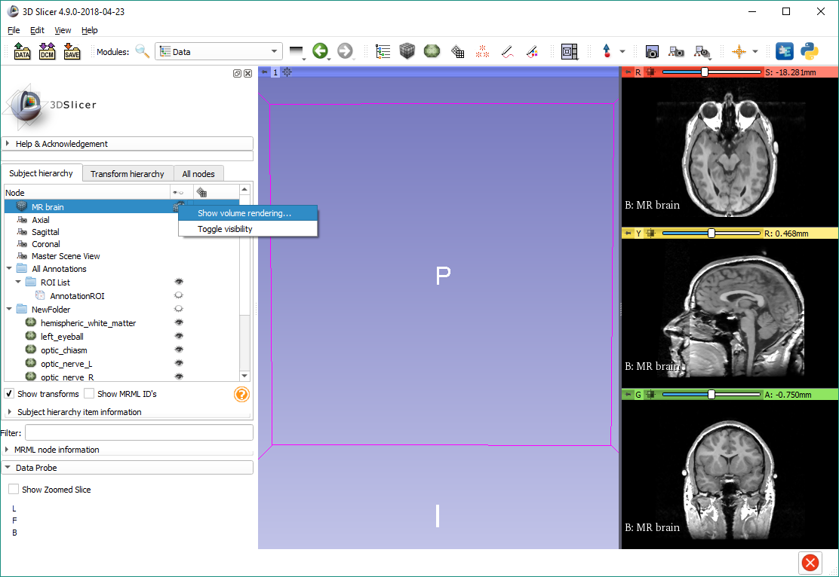
Volume rendering
Note: the Volume Rendering module is also accessible from the modules list

Slide 35
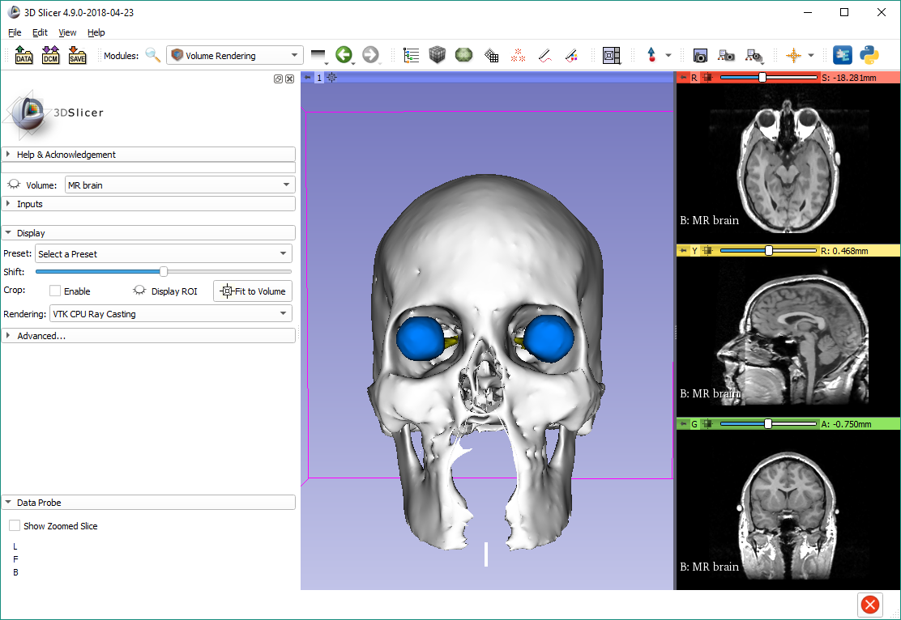
Show volume rendering
If your computer has a capable graphics card, change the rendering option to ‘VTK GPU Ray Casting’.
Note: Most computers should be capable.

Slide 36

Show volume rendering
Click the eye icon to show volume rendering.

Slide 37
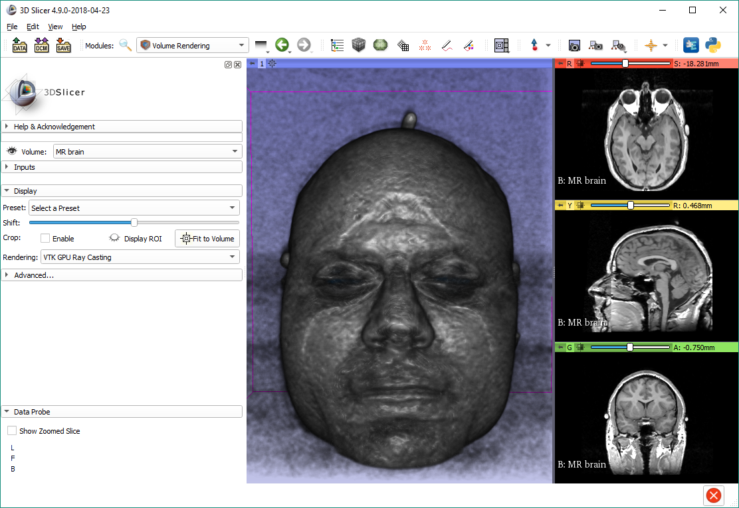
Show volume rendering
For most volumes the default volume properties are not optimal. You need to select a preset.

Slide 38
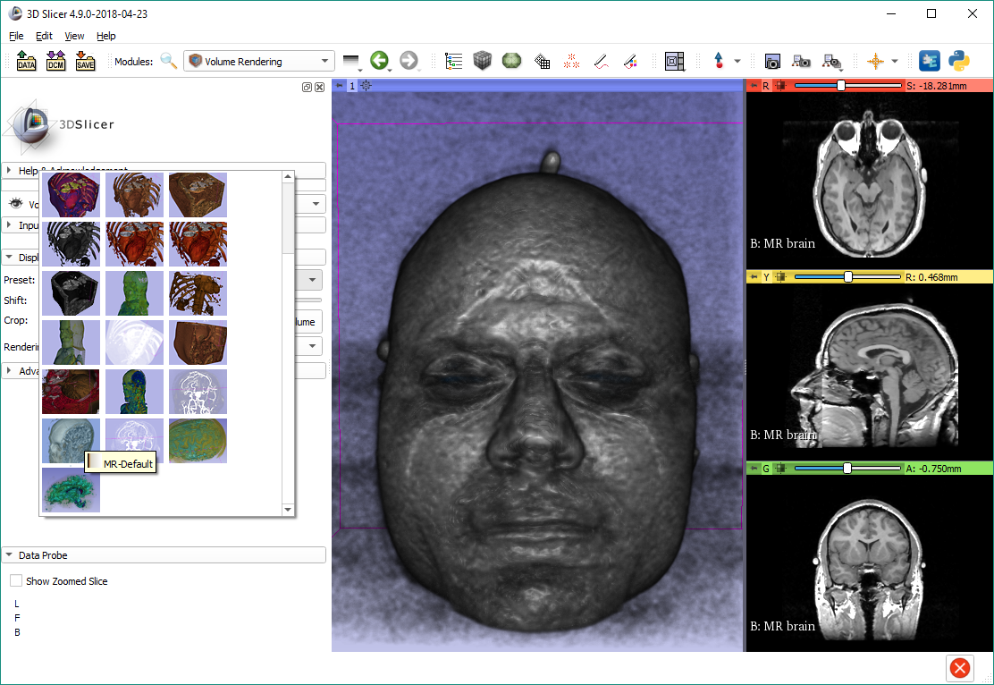
Show volume rendering
Select the ‘MR-Default’ preset

Slide 39
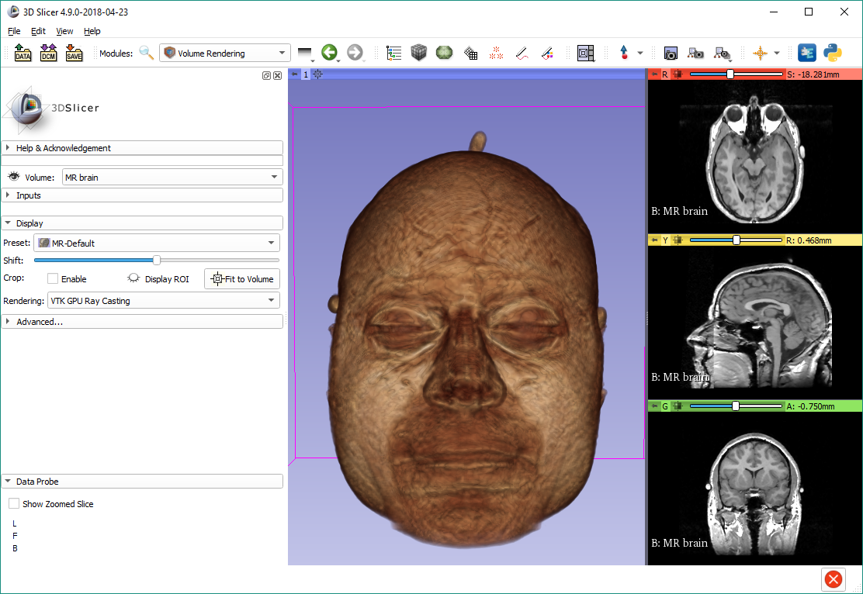
Show volume rendering
Adjust Shift to optimize visualization

Slide 40
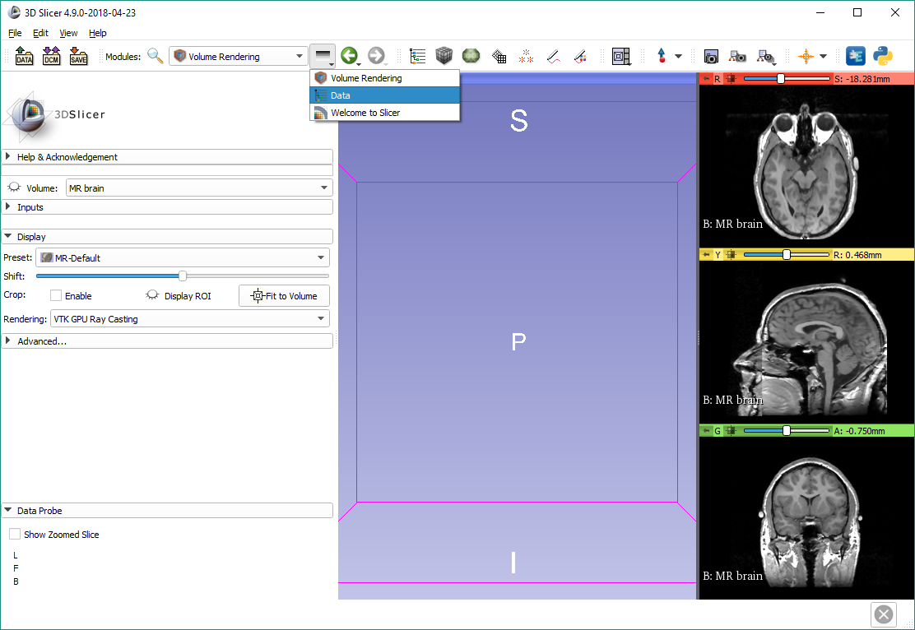
Show models again
Turn off volume rendering using the eye icon.
Switch back to the Data module using the Modules history.

Slide 41
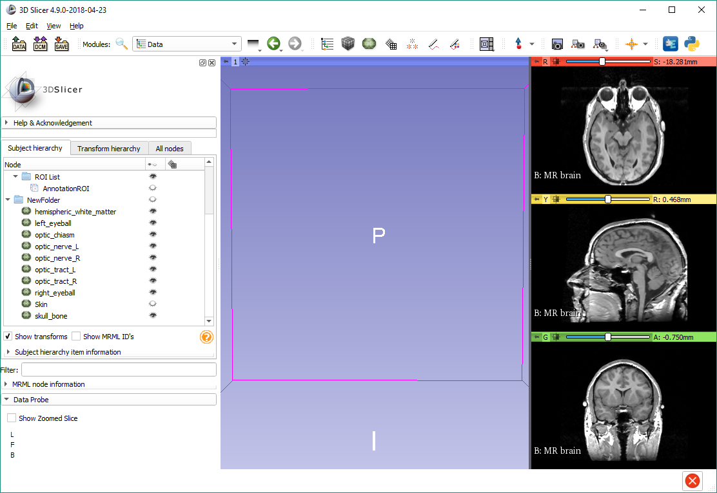
Show models again
Show the folder again by clicking the closed eye icon in its row.

Slide 42
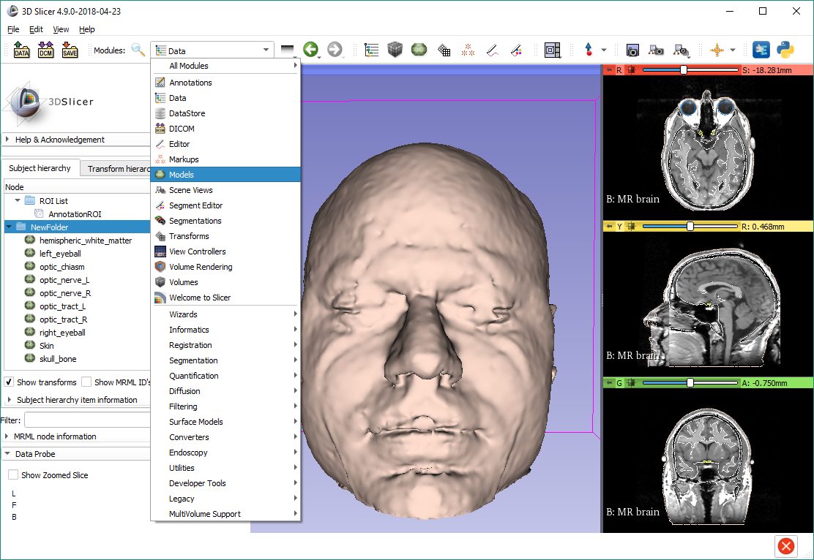
Models module
Switch to the Models module form the module list or the favorite modules toolbar.

Slide 43
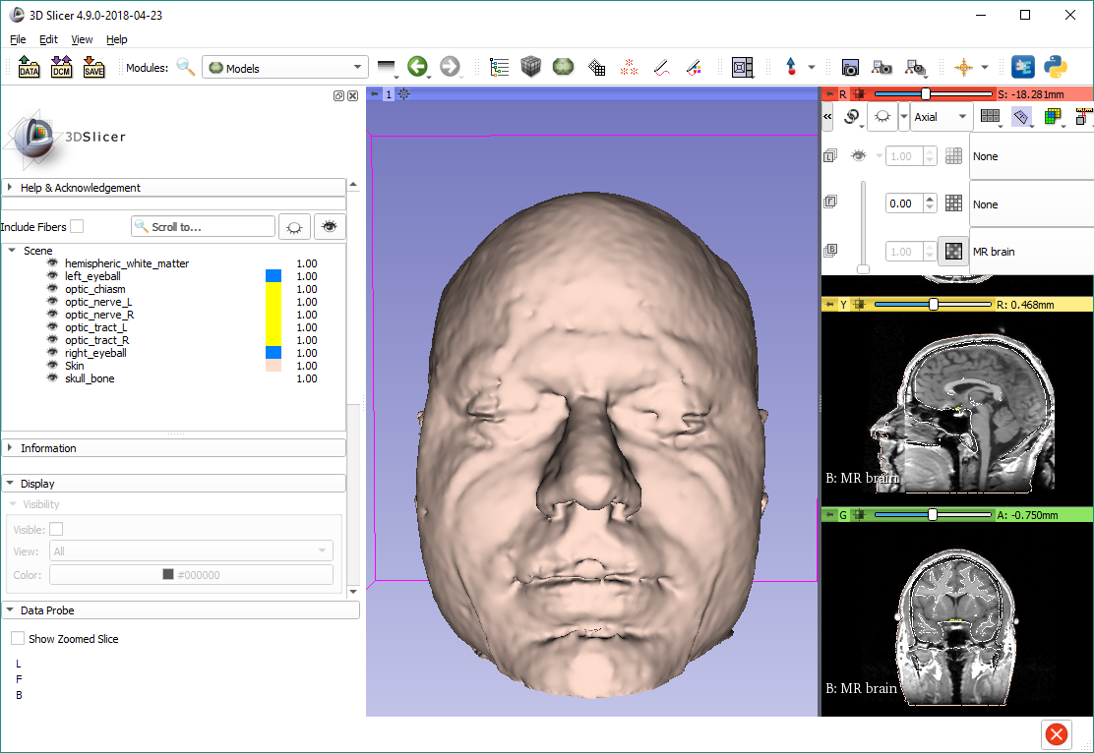
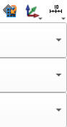
Show axial slice in 3D

Slide 44
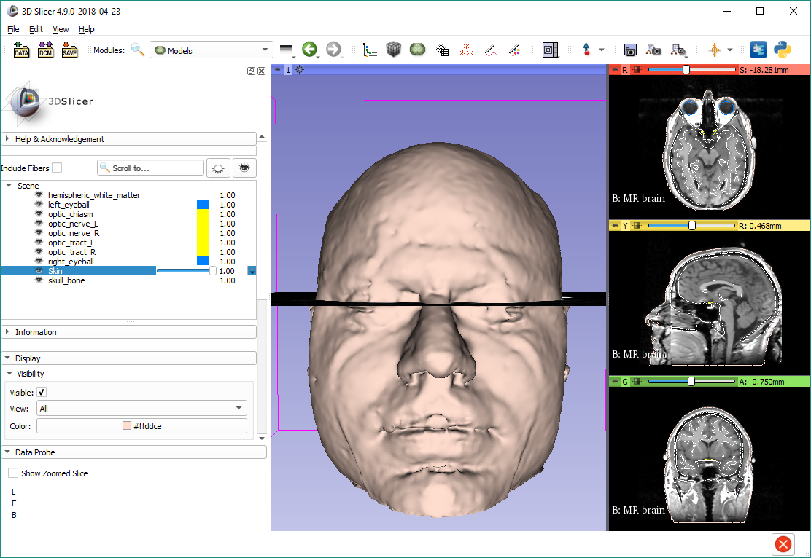
Change skin model opacity
Double-click the opacity column for the Skin model, and adjust the slicer to around 0.30

Slide 45
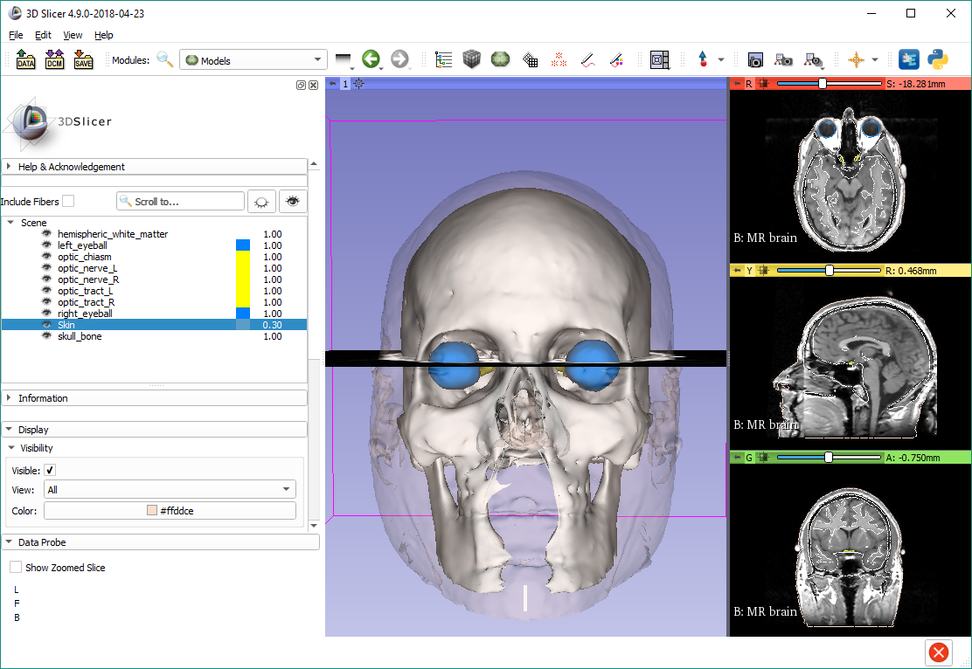
Hide skull model

Slide 46
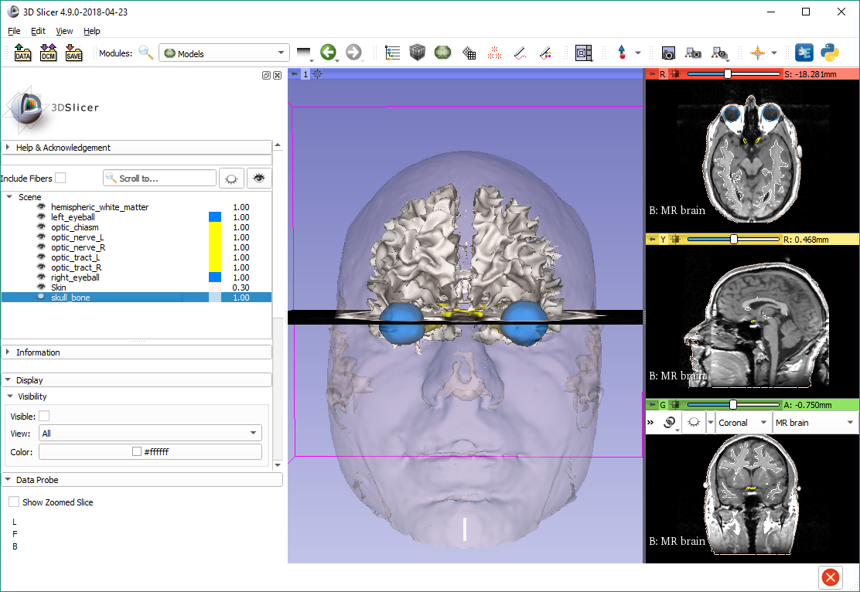
Show coronal slice in 3D

Slide 47
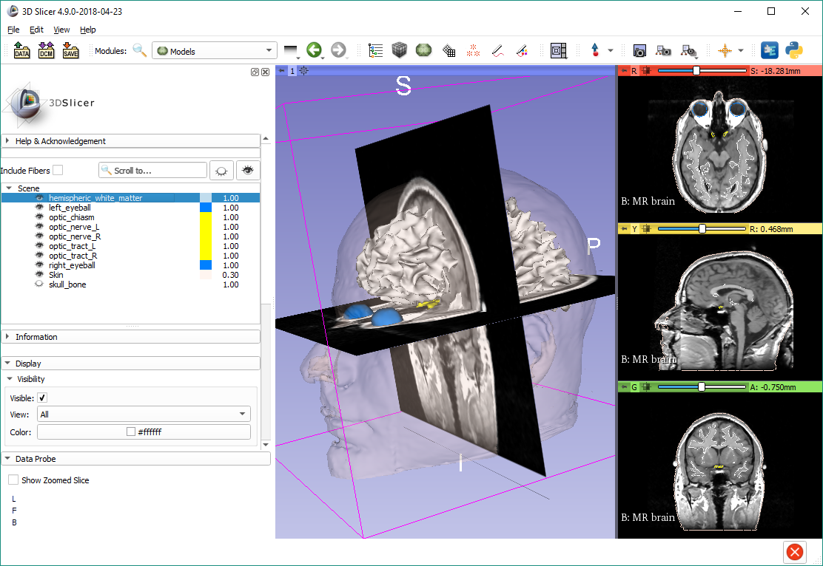
Model clipping
Select ‘hemispheric_white_matter’, then scroll down to the 3D Display section

Slide 48
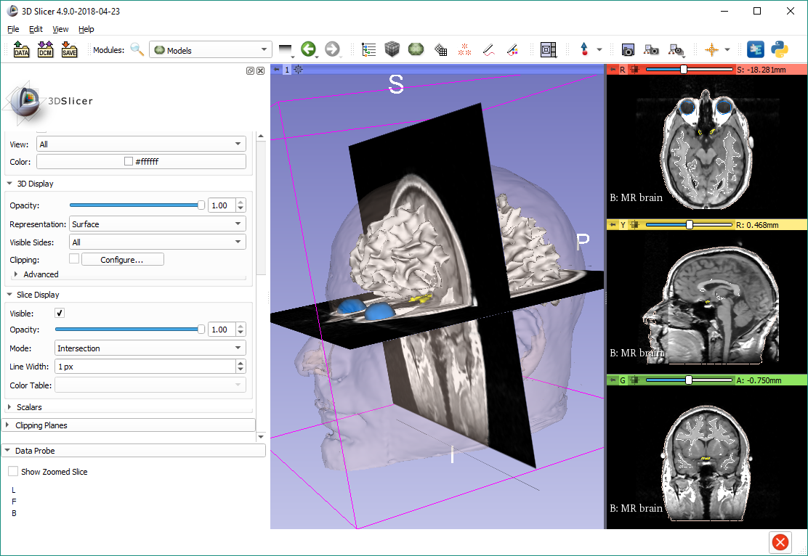
Model clipping
Turn on Clipping

Slide 49
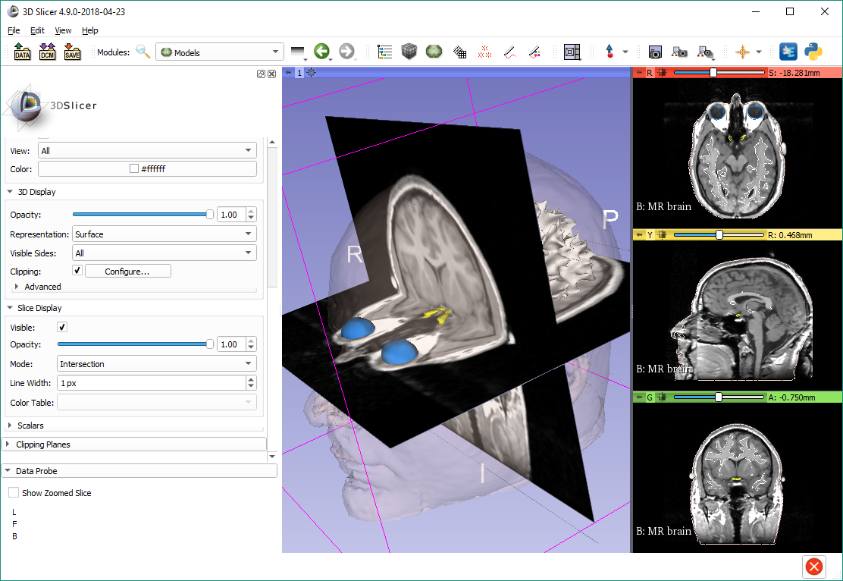
Model clipping
The optic chiasm becomes visible in the 3D view

Slide 50
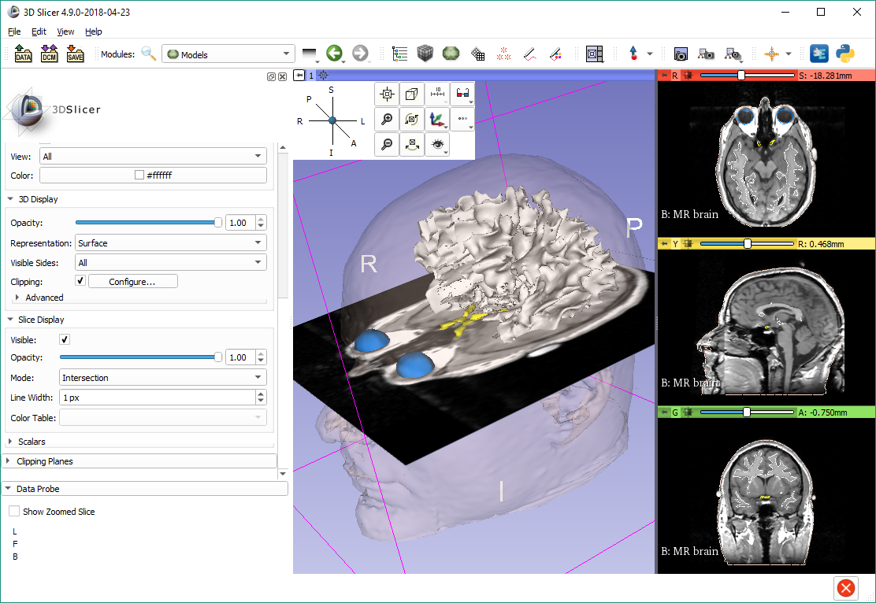
3D display options
Hide the coronal (green) plane. Position your cursor over the pin icon in the 3D view to display the 3D display options. Select the A (Anterior) view.

Slide 51

Save the scene
Click the ‘Save data’ button.
Note: Also accessible from the File menu

Slide 52

Save the scene
The Save Scene and Unsaved Data window lists all elements of the scene.
Double-click the scene (3DHeadScene.mrml), and rename it to myNewScene.mrml. Click Save

Slide 53

Close the scene

Slide 54

Load your scene
Load the new scene using the Load Data dialog, or the previously used method of drag and drop.

Slide 55

Thanks for participating!

